Slide 1
Software Product Management
Prof. Dr. Dirk Riehle
Friedrich-Alexander University Erlangen-Nürnberg
PROD C01
Licensed under CC BY 4.0 International
Notes:
It is Friedrich-Alexander University Erlangen-Nürnberg – FAU, in short.
Corporate identity wants us to say “Friedrich-Alexander University”.

Slide 2
Software Product Management (Recap)
(Software) product
  A man-made physical or virtual artifact offered for sale to customers in a market
(Software) product management
  The management of a company’s products (along the product life-cycle) (across the product portfolio)
(Software) product manager
  The person tasked with performing product management at a product company

Slide 3


Slide 4
Main Questions (re: Products)
What?
What should we be doing?
Why?
Why should we be doing it?
When?
When is the time for doing it?

Slide 5
Video From “The Pentagon Wars” [1]
The Bradley Vehicle
(10+ years in the life of a project manager)
[1] https://youtu.be/r0op8e0LuoU
[1] https://youtu.be/AHSjpFUKQR4

Slide 6
Video Lessons
Multiple stakeholders: Bargaining leads to suboptimal results
Meddling stakeholders: Intervening in the tank design process
Unclear market: From US military to foreign markets
Cost explosion: With changing requirements, costs explode
Inconsistent requirements: From fast and small to big with firepower
Changing requirements: Lack of focus invalidates prior work
Feature creep: From troop carrier to tank

Slide 7
Main Responsibilities
Definition of product vision
Economic rationale (business plan)
Strategic positioning within portfolio
Specification and prioritization of features
Mapping of features into releases into time

Slide 8
Communication with Stakeholders
With leadership
  To ensure buy-in
With marketing
  To communicate the story to the market
With engineering
  To have the right product built
With finance
  To ensure funds don’t run out
With support
  To ensure a whole product

Slide 9
Product Manager in Context
Customer (C)
Account Manager (AM)
Marketing Manager (MM)
Product Manager (PM)
Engineering Manager (EM)
Software Developer (SD)
Test Engineer (TE)
Support Engineer (SE)
AM
EM
SD
C
PM
TE
MM
SE

Slide 10
Product Management vs …
Marketing Management
Engineering Management
Project Management
User Experience Design

Slide 11
Marketing vs. Product Manager
Marketing manager
  A.k.a. “outbound marketing”
  Markets to customers
Product manager
  A.k.a. “inbound marketing”
  Learns from customers

Slide 12
Engineering vs. Product Manager
Engineering Manager
  Is to realize product
  Has 5-20 times larger staff than product manager
Product Manager
  Is to define product
  Small or no staff

Slide 13
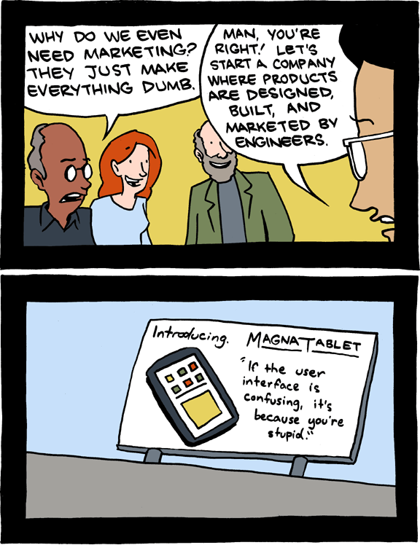

Slide 14
Project vs. Product Manager (Recap)
Project Manager
  Is to manage project, including people
Product Manager
  Typically not involved in any projects
  May define project services as part of whole product

Slide 15
UX Designer vs. Product Manager
User experience designer
  Conceives user experience, includes
    Information visualization
    Interaction design
Product manager
  Provides the functional input for UX design
  May be manager (superior) of UX designer

Slide 16
Product Management within a Product Firm
Management
Sales and Marketing
Product
Management
(Inbound
Marketing)
Engineering
Other
(HR, Office, Finances, ...)
Sales
(Outbound)
Marketing
Development
Support

Slide 17
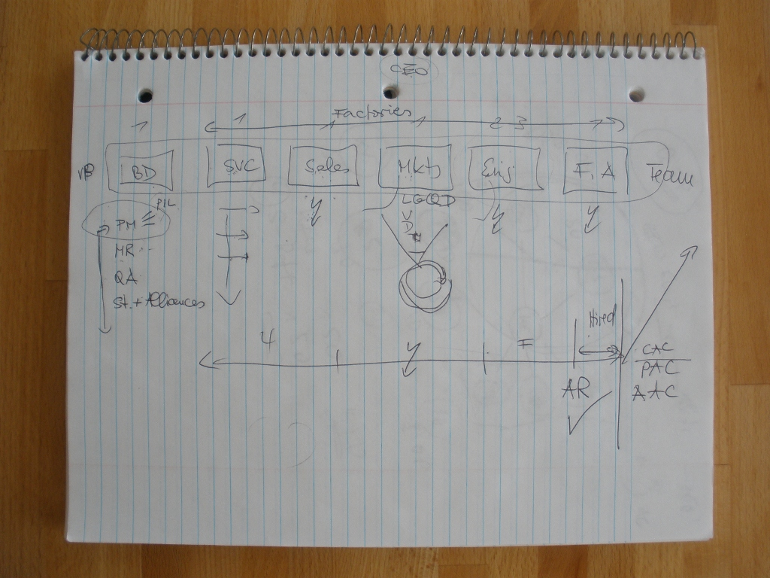

Slide 18
The Role of the Product Manager
CEO of the product
  Holds overall responsibility for the product (including revenue responsibility)
Voice of the customer
  Channels market requirements towards development

Slide 19
More Definitions
Product life-cycle
  A model of the stages that mark a product’s life-time
Product roadmap
  A plan of the evolution over time of a product’s key features
Product portfolio
  The group of products sold by a company and their relationships

Slide 20
Product Management Careers
Sales and Marketing
Product Management
Engineering
Chief Product Officer
...
...
...
Jr. Sales Associate
Jr. Product Manager
Jr. Engineer
Business
Student
Engineering
Student

Slide 21
Functions of Product Management
Strategic Product Management
  Focuses on assessing and defining the market opportunity
  “Owns” the Marketing Requirements Document, which
Technical Product Management
  Focuses on defining the product and its features
  “Owns” the Product Requirements Document, which

Slide 22
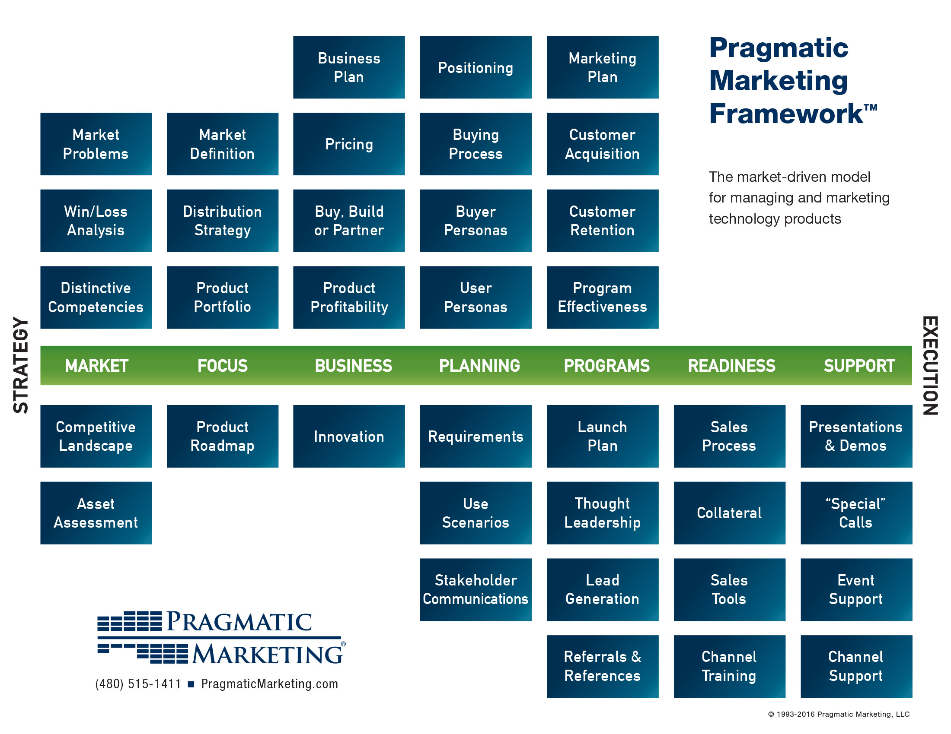

Slide 23
Strategic
Technical

Slide 24
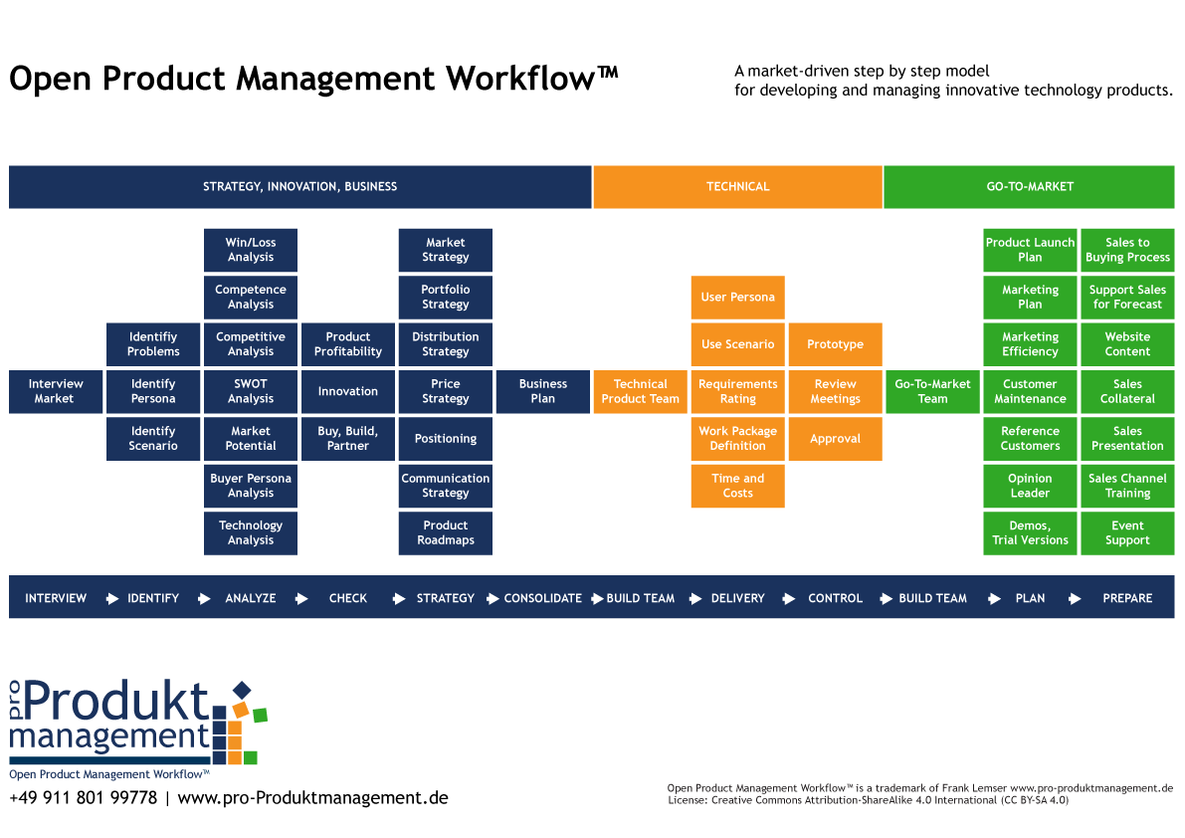

Slide 25
Review / Summary of Session
Product Management
  The what, why, and when?
  Compared with other functions
  Within the corporate context
Domains of product management
  Product roadmap
  Product life-cycle
  Product portfolio

Slide 26
Thank you! Questions?
dirk.riehle@fau.de – http://osr.cs.fau.de
dirk@riehle.org – http://dirkriehle.com – @dirkriehle
DR

Slide 27
Credits and License
Original version
  © 2012-2019 Dirk Riehle, some rights reserved
  Licensed under Creative Commons Attribution 4.0 International License
Contributions
  ...

